Slide 1
Tortuosity – A web based quiz
Final presentaiton

Slide 2
Play the game
https://tortuositymmu.firebaseapp.com/

Slide 3
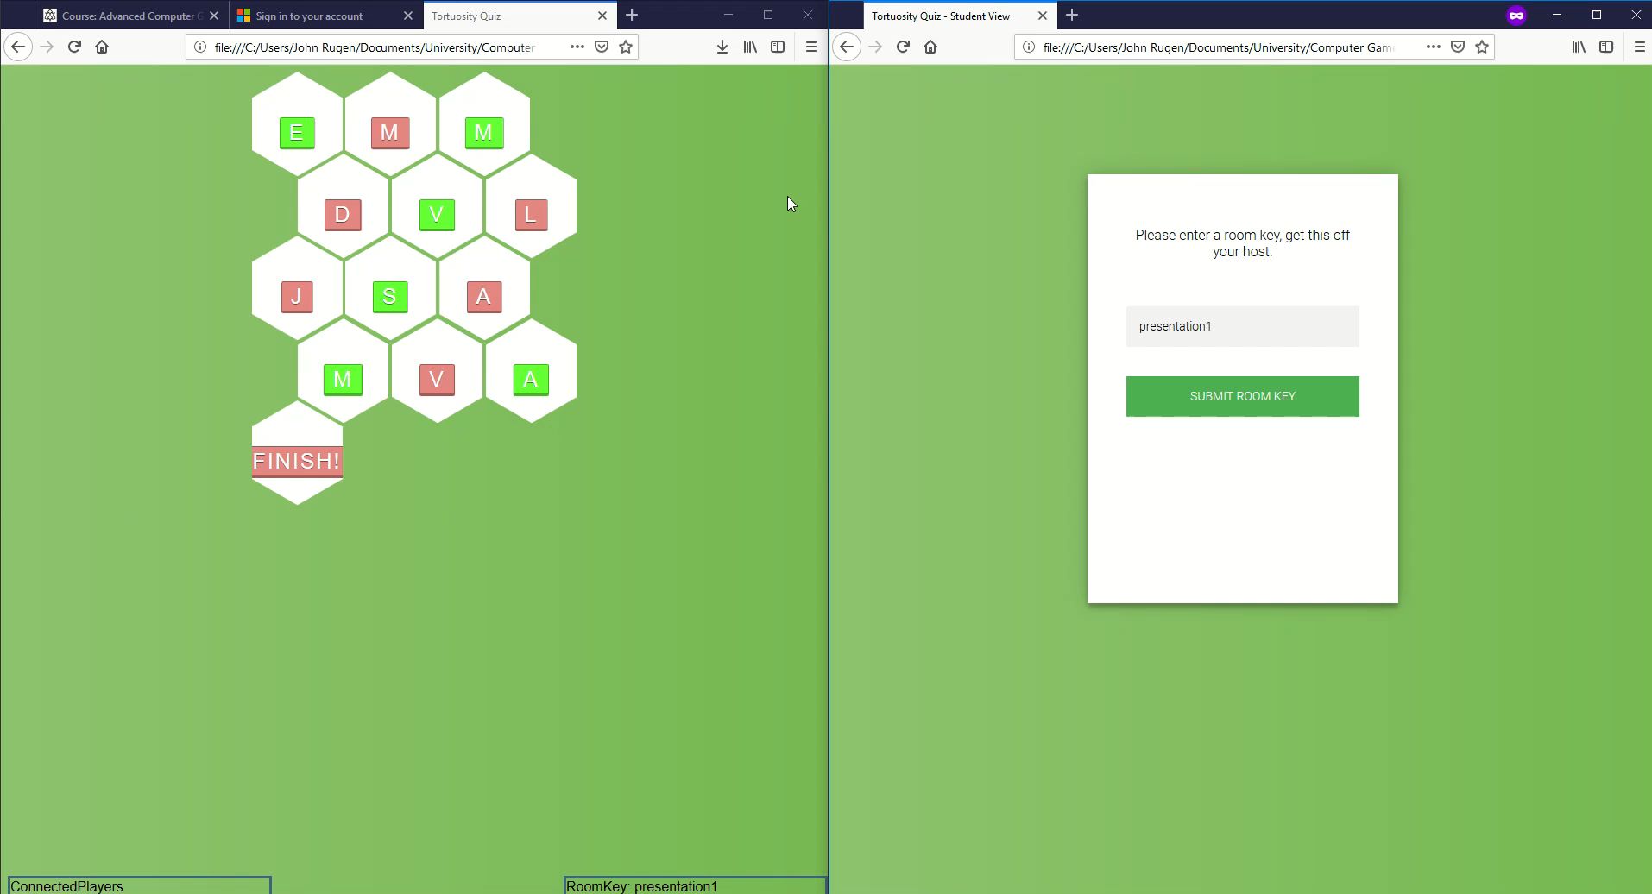
Video

